Slide 1

Galactic Credits Prediction
Blake Curtsinger, Drew Glaze, Michael Catapano, Tyler Johnson

Slide 2
Credit Data - Initial Observations
Trending upwards over time and has non-constant seasonal patterns.
In other words, the seasonal patterns vary from stronger to weaker over time.
Several transformations were tested to eliminate the changing seasonality, but none were successful.
Therefore, we kept the data as is to use for our predictive model.
STL Decomposition separates the trend, seasonal, and randomness elements of the series. This further confirmed the seasonality and non-constant variance.

Slide 3
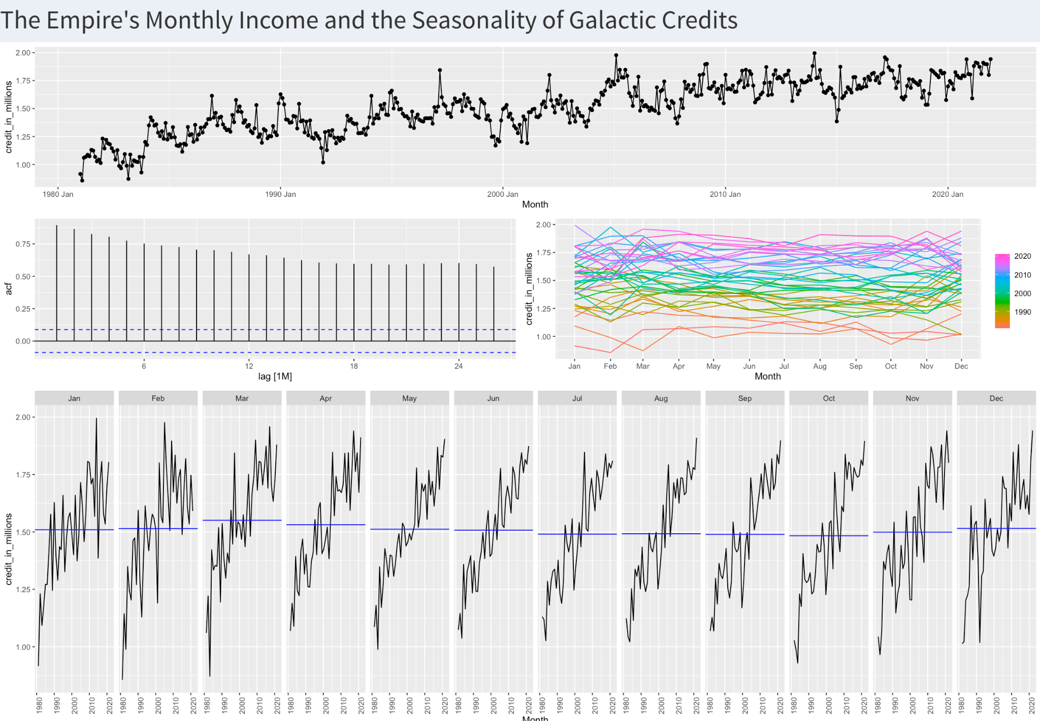

Slide 4
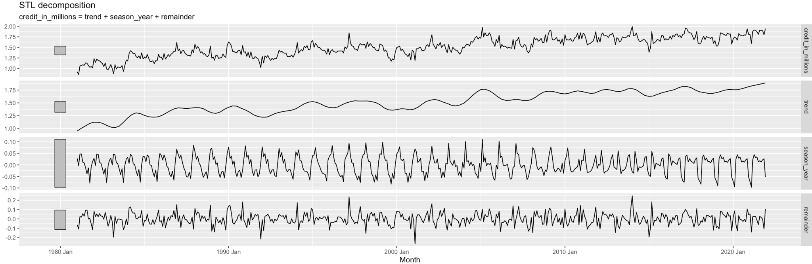

Slide 5
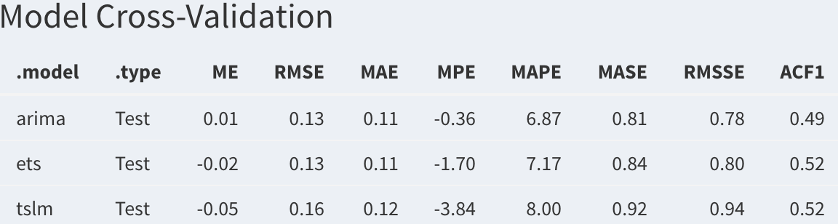
Our Process - Cross-Validation
We began by splitting the data into a “training” subset and a “testing” subset.
Training data will be used to train our models by making predictions on all of the data except for the last 12 months.
Testing data will be used to validate our models by predicting the last 12 months after the training process.
We compared 3 models: ARIMA, Linear Regression, and Exponential Smoothing.
Our preferred accuracy metric is the Root Mean Squared Error, and the ARIMA model performed the best in terms of that.
RMSE - The average error our model makes when making predictions.

Slide 6
Final Model Evaluation
Once we fit our final ARIMA model, we then checked a plot of its residuals. We were pleased to see that there are no patterns, indicating that there are no trends with our model’s mistakes. In addition, past mistakes cannot be used to predict future mistakes which is a good sign.
Then, we evaluated the predictions on our testing data.
The RMSE was 0.09146992, so on average our model makes an error of about 90,000 credits when predicting revenue.

Slide 7
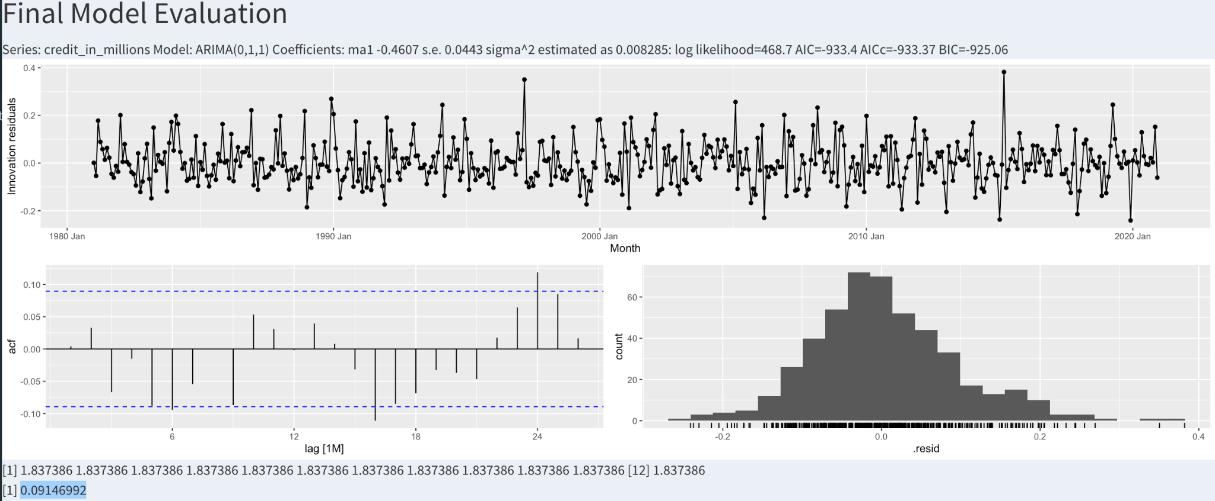

Slide 8
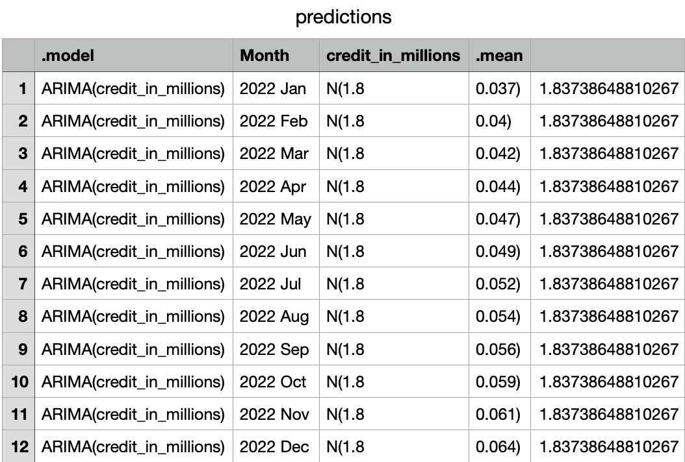
12 Month Forecast

Slide 9
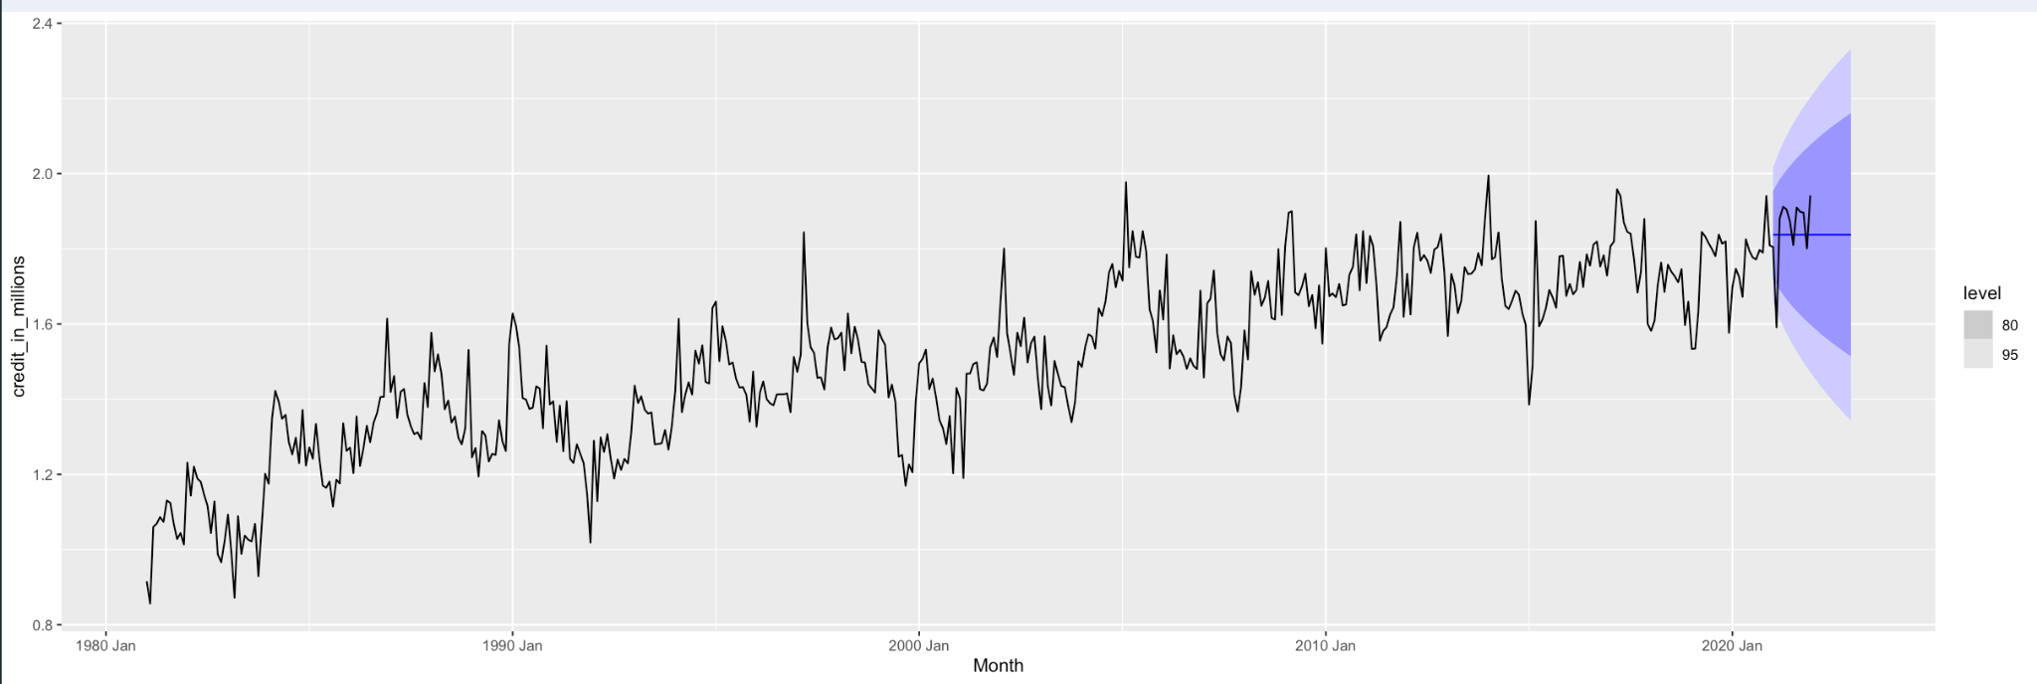
12 Month Forecast (Cont.)

Slide 10

Reflection
Overall, we feel that the model could use some improvement before it is fully implemented as a Credit prediction tool.
More experimentation in model building could lead to better results.
Different transformations could be applied to eliminate seasonal variance
However, we were pleased with our low RMSE, as the typical miss from the model is only 0.091 (in millions).

